Slide 2
Blessed are the meek, For they shall inherit the earth. Matthew 5:5

Slide 3
The Earth
Inheriting

Slide 4
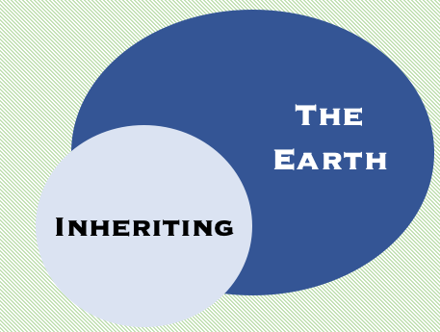
Now
Not Yet
Therefore the Lord Himself will give you a sign: Behold, a
virgin* will be with child and bear a son, and she will call His name Immanuel.
Isaiah 7:14
*alma: virgin / young woman
“She will bear a Son; and you shall call His name Jesus, for He will save His people from their sins." Now all this took place to fulfill what was spoken by the Lord through the prophet:… quotes Isaiah 7:14.
Matthew 1:21-22
When will this happen? v.15f
Before the boy is old enough to know right/wrong Syria and
N. Kingdom will be destroyed.
Just a few years later.
So who is it? Jesus, not
Isaiah’s son?
It may look like
this…
So who is it? Isaiah’s son
in chp. 8

Slide 5
Virgin
Birth
“virgin” birth

Slide 6
The Kingdom Coming
2 Pet. 1:11
The kingdom came
Col. 1:13

Slide 7
Resurrection
John 5:28-29
1 Cor. 15
Resurrection
Rom. 6:1-11

Slide 8
Inherit the Earth
???
Inherit the earth
???

Slide 9
Hosea 2:14-23
Isaiah 32:12-20
Fulfillment: in the days of the kingdom (Rom. 9:25, 1 Pet. 2:9-10)
Fulfillment: in the days of the kingdom (Acts 2:38f, Titus 3:5f)
Notice Imagery:
Wilderness to Vineyard (14-15)
Covenant with animals (18-19)
That results in safety (19)
Sky answers the land, the land produces because of God (21-22)
God will sow “her” into the earth
(23)
Notice Imagery:
From Wilderness (12-14)
To a fruitful field (15-16)
That results in safety (17-19)
Abundant sowing and reaping, grazing for animals (20)
So what is the earth imagery God uses? Same: People. It is a renewed “earth” reversing the curse on the ground (13).
So what is the earth imagery God uses? It is a parallel for God’s new people living in His blessing

Slide 10
Let’s tie it all together
Isaiah 65:15-19 will tell us what God calls this “place”:
new heavens and new earth (a new people, Jerusalem,
a new kingdom)
So what will the meek inherit? This new kingdom,
Jerusalem (Zion), and… a new heavens/earth.
What does that mean practically without the imagery?...
The meek will really be His people, living in
complete peace, with no weeping or crying.
If you are in Christ you have inherited this new “earth”
(2 Cor. 5:17, 1 Cor 3:21-23)
Now, Not Yet
There’s one problem with this.
We still see crying and weeping.
There is not utter peace/righteousness.
The garden curse isn’t reversed; still have death.

Slide 11
If we get this….
The Kingdom Coming
2 Pet. 1:11
The kingdom came
Col. 1:13

Slide 12
Then we get
this….
New Heavens
New Earth
(Ultimately)
New Heavens
New Earth
(now)

Slide 13
N.H.N.E.
Had a deeper meaning in God’s ultimate plan:
Rom. 4:13-14
8:18-23
2 Peter 3:10-13
Acts 3:19-21
Rev. 21-22
New Heavens
New Earth
(now)

Slide 14
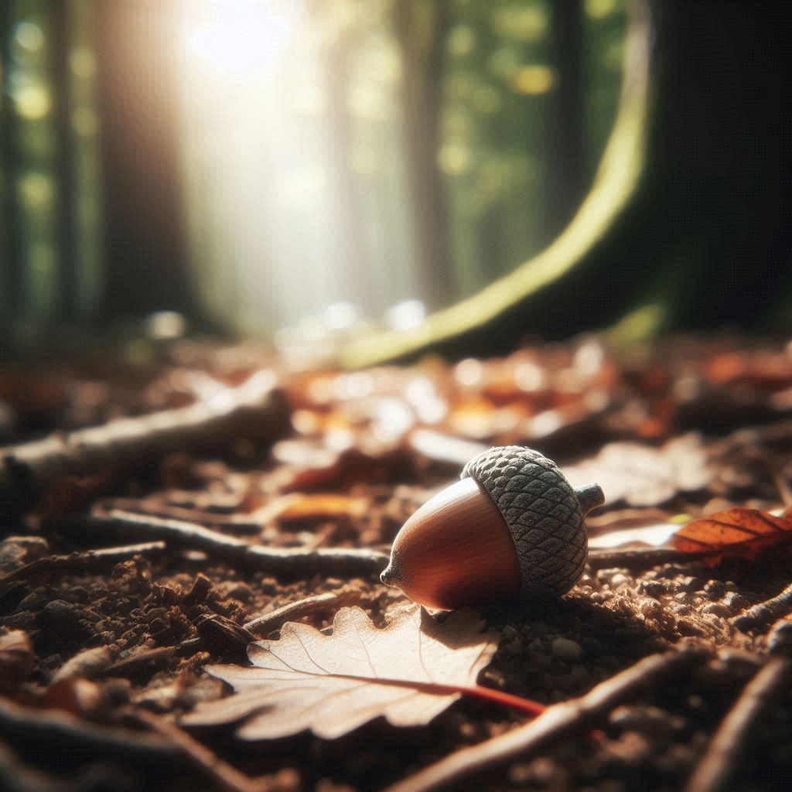
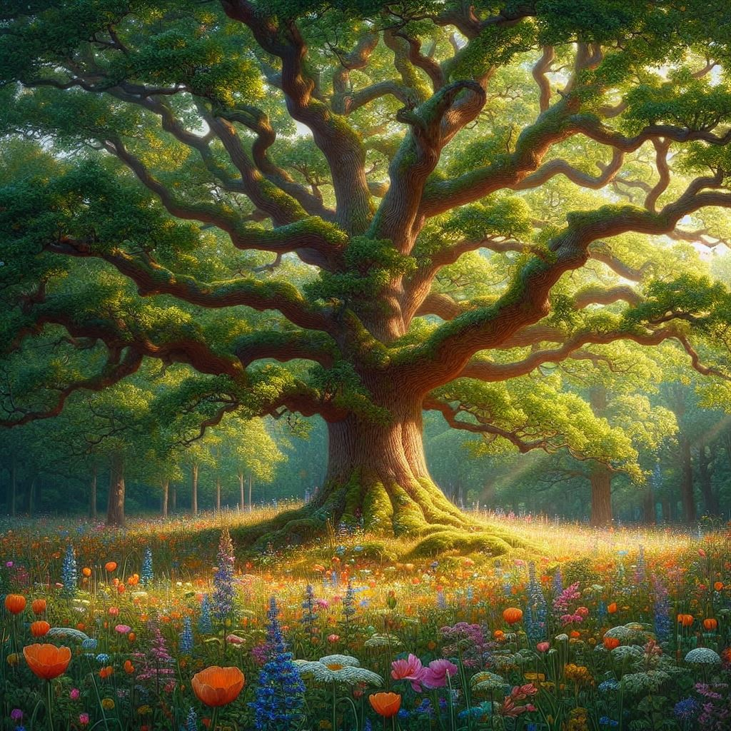
What’s it going to be like?
From 1 Cor 15
Before the Resurrection
At the Resurrection
Our current body (flesh and blood)
New body
Like a seed (v.37)
Different as the plant
First heaven and earth
New heaven and earth

Slide 15
So what?
Kick the bucket list.
We are living now within those beautiful images. Abundance and Peace. (Mk. 4)
The life we live now is a foretaste of what is to come. If not, why not?
From Garden to Garden

